Slide 1
IRR is already below cost of capital in 2017
0% IRR by 2020
Source: Deloitte & BCG, 2016

Slide 2
NME | Avg. NME R&D Spend per Project ($) | Market Entry per FDA Approval (Years) | Probability of Approval | Total Average R&D Spend Per Year ($)
 | ~2.6B | 15 | 5% | ~173M
IKU | Avg. Redevelopment R&D Spend per Project ($) | Market Entry per FDA Approval (Years) | Probability of Approval | IKU Average R&D Spend Per Year ($)
 | ~10M – ~100M | 5 | 30% | ~2M - ~20M
Infrastructure | Current | IKU
Tx Finality | Lacking; Not Atomic Court Enforced (Litigation) | Final; Atomic Blockchain Enforced
Licensing | Analogue | Digital; Smart Contract
Efficiency | Non-liquid; Limited by Jurisdiction | Globally Liquid
Barrier to Entry | High | Low

Slide 3
$40.94 Billion
~25% (~ $9 billion)
$31.77 Billion

Slide 4
RFP
Research
Target
Library Exchange
Peer Review
s > r
RST[x] minted
(softcap reached)
Live
Sub-network
+
Trading
RST[x} DC Liquid R&D Ongoing

Slide 5
EXISTING R&D MODELS ↓ | Clinical Trial Funding | Patent-Agnostic R&D | Liquid R&D | Open Innovation | R&D is Publicly Available | Digital License
Big Pharma | Yes | No | No | No | Very Limited | No, Analog
VC | Yes | No | No | No | Very Limited | No, Analog
IKU | Yes | Yes | Yes | Yes | Yes | Yes, Smart Contract
U.S. NIH | Very limited | Yes | No | Very Limited | Yes | No, Analog
Foundations | Very limited | Yes | No | Very Limited | Very Limited | No, Analog
Current Medtech Crowdfunding | Very Limited | No | No | Limited | Limited | No, Analog

Slide 6
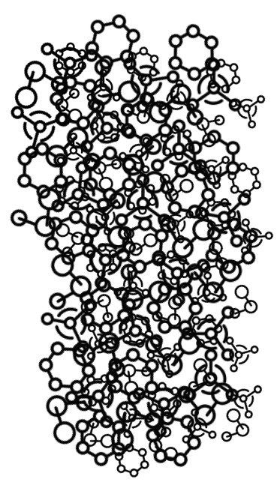








FDA
Review
Drug Discovery
Pre-Clinical
Clinical Trials
Clinic
10,000 compounds
(NME)
250 Compounds
(NME)
5
Compounds
(NME)
1
Drug Approved
6.5 Years
6 Years
1.5 Years
IKU Market Entry < 5 Years
$2.6 Billion NME R&D Spend
NME
$10 - $100 Million
IKU Rediscovery R&D Spend
IKU

Slide 7
FDA
Review
Drug Discovery
Pre-Clinical
Clinical Trials
Clinic
10,000 compounds
(NME)
250 Compounds
(NME)
5
Compounds
(NME)
1
Drug Approved
6.5 Years
6 Years
1.5 Years
$2.6 Billion NME R&D Spend
$10 - $100 Million
IKU Rediscovery R&D Spend
NME
IKU
IKU Market Entry
< 5 Years
NME

Slide 8
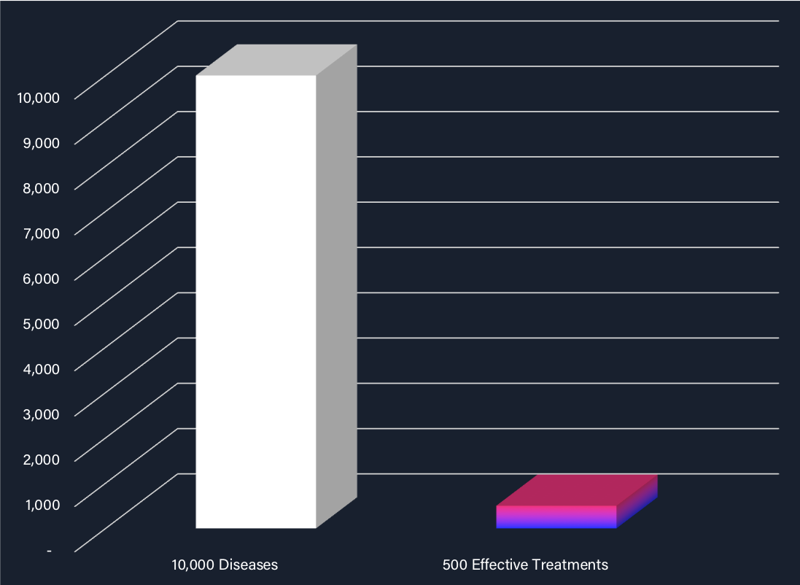

Slide 9










Academia
Pharma

